Slide 1

Clickbait: News Headline Classification
Sean Jeong
Notes:
- Hi, I'm Sean and today I would love to share my project
- Clickbait: News Headline Classification.

Slide 2

Who am I?
Unique approach to Data Science:
Biochemical Research
Shipping Logistics
Building Management
Notes:
- Through the problem-solving skills acquired from biochemical research
- Creativity required in shipping logistics and communication from building management
- I can provide a unique approach to data science

Slide 3

What’s the purpose?
Notes:
- Everyone encounters so much information everyday
- Originally, I wanted to combat news misinformation
- But developing a fact checking algorithm was a challenging process
- Instead, I decided to tackle sensationalized news headlines, or in modern terms - 'clickbait'.

Slide 4
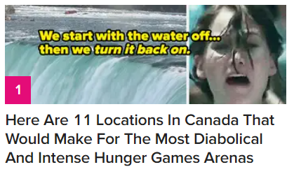
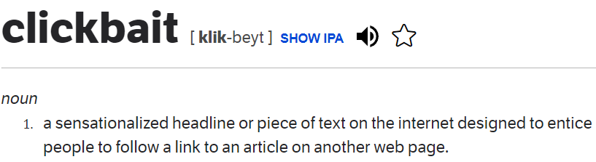
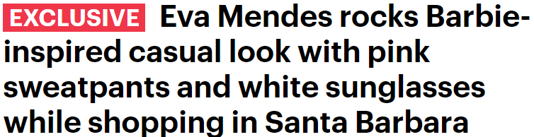


Notes:
- Dictionary.com, clickbait is defined as a sensationalized headline designed to entice
- Examples including breaking news such as this or this.

Slide 5

What are the goals?
Which networks have the most clickbait headlines?
What criteria best determines sensationalism?
Notes:
- Overarching goals of the project is to determine A and B
- Something to note, is that sensational headlines doesn’t always determine the quality of article,
- After all, media is an industry designed to catch our attention

Slide 6
What did the process look like?
Collecting Data
- Baseline from News API
Creating Features
- Sentence Characteristics
- Tuning Parameters
Improving Predictions
Evaluating Models
- Feature Relationships
- Random Forest
- News Dataset from Kaggle
- XGBoost
- Adding Features
Visualizing Trends
- Word Quality
- Variable Outliers
Notes:
- First, I developed a baseline from the News API and a larger test dataset from Kaggle
- Then, I created 6 features based on sentence characteristics, word quality
- After, we could see relationships and outliers in the data with different graphs
- Eventually we evaluated 2 models, deciding to use Random Forest because it had higher accuracy
- Finally, I found the best parameters, I added new features, to improve the model

Slide 7
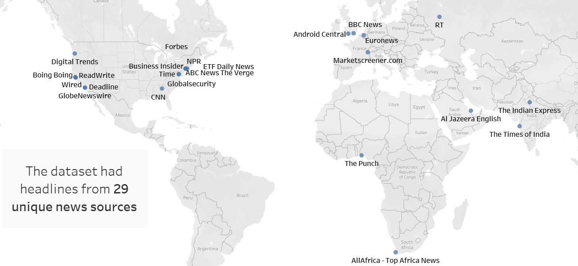
How was the data collected?
Notes:
- The Kaggle news dataset had over 46,000 headlines from 29 unique news sources
- Their head offices are located as shown on the map
- Also, as it featured international media companies, non-English headlines were removed

Slide 8




Associated Press
Reuters
Buzzfeed
Entertainment Weekly
Non-Sensational (0)
Sensational (1)
Notes:
- Associated Press, Reuters were labeled as non-sensational and Buzzfeed, Entertainment-Weekly were sensational to serve as the baseline
- This was determined through reports by All Sides, media bias company

Slide 9

What features were used to classify headlines?

Slide 10
Headline: “60 Gifts You Basically Can’t Go Wrong With” Processed: “gift basic cant go wrong”
8
Words in Headline
4.38
Avg Word Length
4
Avg Key Word Length
0.13
1
0.88
4
Buzzword Ratio
Unique Ratio
Uppercase Ratio
Notes:
- Headlines were pre-processed for language analysis functions by removing case, punctuation, non-letter characters, stop words, then changing to base form
- Features either used the original or processed headlines, includes:
- Words in Headline
- Avg word length which measures how many letters are in each headline word, key word length for in processed headline
- List of common buzzwords such as scandal, surprising was added to a list of top 20 most common words from buzzfeed, entertainment weekly
- Unique word counts how many unique words are compared to the total, while uppercase compares capitalized words

Slide 11
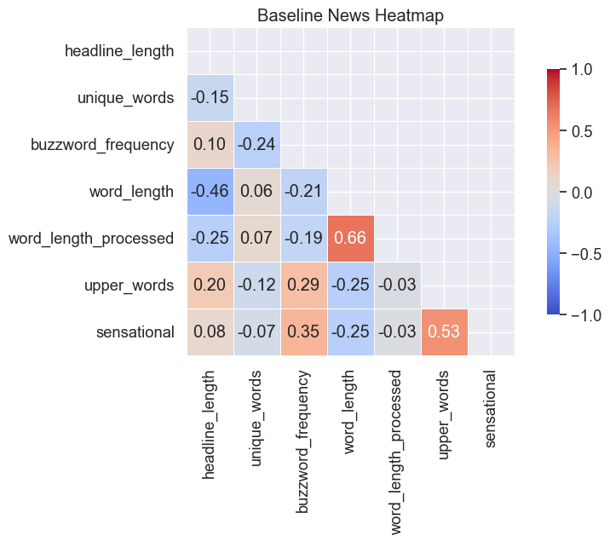
What trends were discovered?
Sensationalism increases with:
Uppercase Ratio (+)
Buzzword Ratio (+)
Avg Word Length (–)
Notes:
- Some patterns between sensational headlines and features include:
- The uppercase ratio is hypothesized because named entities such as people or organizations, or if a headline wants to display excitement - headlines tend to be capitalized.
- Buzzwords tend to be adjectives, adverbs used to over describe headlines
- Shorter words seem to grab attention easier than words like denounced, amendments

Slide 12

What did the model show?

Slide 13
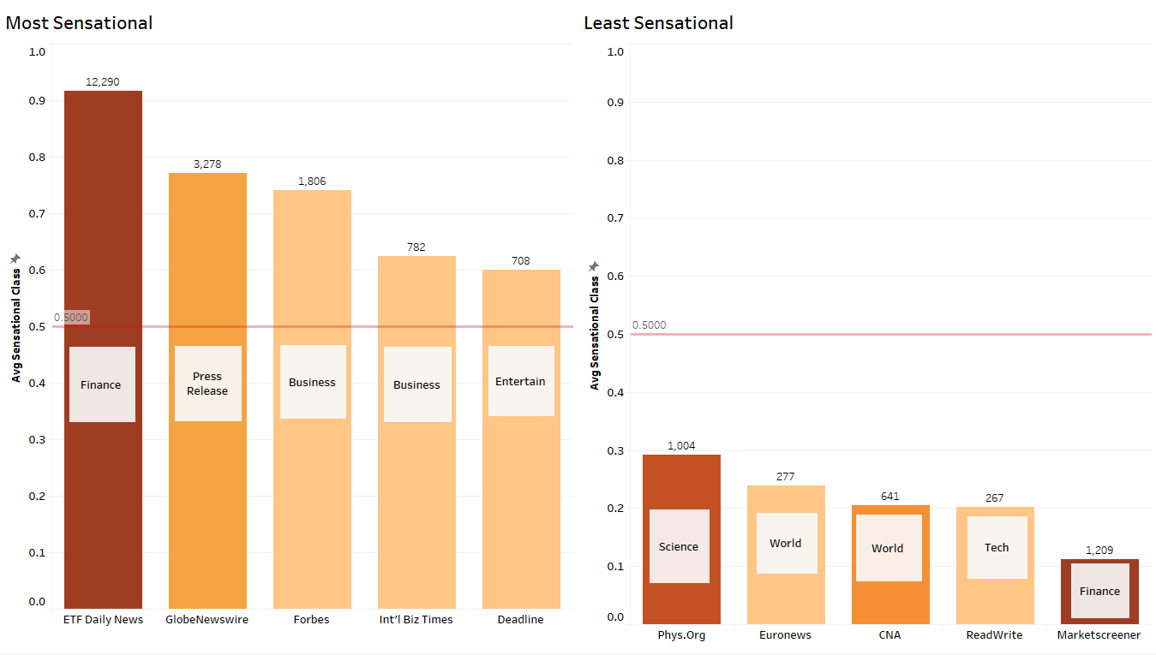
Notes:
- This visualization shows the top 5 most and least sensational news sources by average sensational class
- If sources are above the 0.5 threshold, their headlines are more likely to be sensationalized on average, and not if lower
- The colours and values on top show the number of headlines in the dataset
- The type of news the sources report are labeled as well
- I thought it was interesting that both finance news sources were most and least sensational
- However ETF news on the left reports on very short stock price updates featuring just stocks and companies tend to be capitalized
- While marketscreener on the right, reports finance happenings in a traditional reporting manner

Slide 14


How can the model be improved?
Clustering
Part of Speech (POS) Tagging
Test news dataset was unlabeled and ungrouped
Clustering algorithms such as K-Means can group headlines
The groups can be analyzed to see how it is significant
Adjectives, adverbs are common in news headlines
POS tags label the category of words in a sentence
Compare the frequency of word categories to sensational class
Notes:
- I thought of 2 of many ways the model can be improved
- The first is by integrated unsupervised learning models
- The second is training my own part of speech tagger, such as nouns/verbs/adjectives

Slide 15

Thank You
GitHub @ seansjj
LinkedIn @ Sean Jeong
Notes:
- Thank you for listening to my presentation
- If you are ever curious to see what projects come next
- Feel free to check my profiles

Slide 16
Photo Credits
Slide 1 – Filip Mishevski
Slide 3 – Craig Whitehead (L), Logan Weaver (M), Omid Armin (R)
Slide 12 – Safar Safarov

